Slide 1

IE 260 – ENGINEERING ECONOMY Replacement Analysis Scenarios
U. MAHİR YILDIRIM

Slide 2
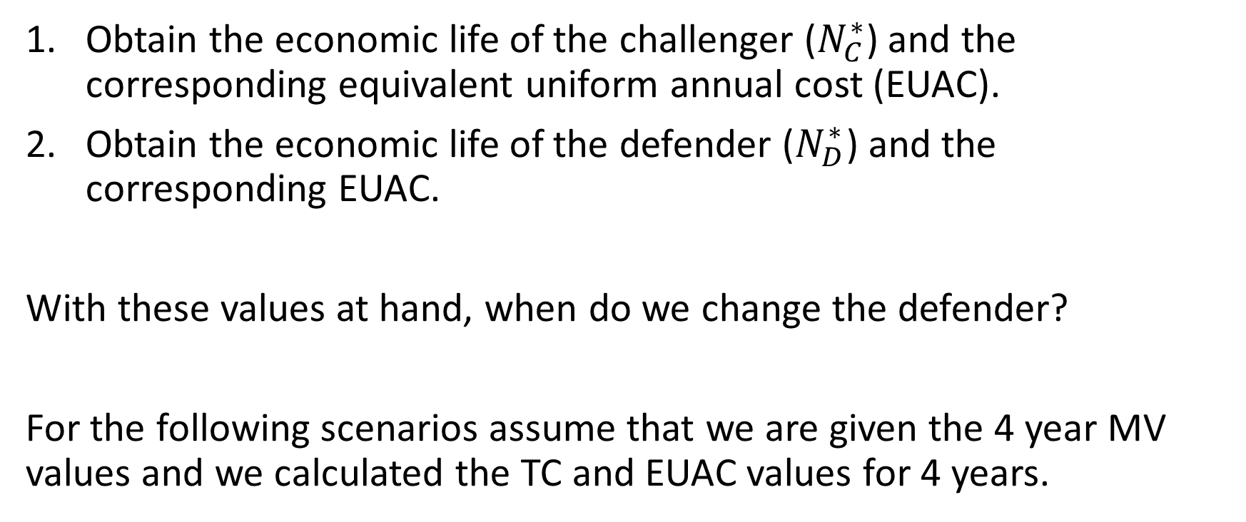
Replacement Analysis
Obtain the economic life of the challenger ($N_{C}^{∗}$) and the corresponding equivalent uniform annual cost (EUAC).
Obtain the economic life of the defender ($N_{D}^{∗}$) and the corresponding EUAC.
With these values at hand, when do we change the defender?
For the following scenarios assume that we are given the 4 year MV values and we calculated the TC and EUAC values for 4 years.

Slide 3
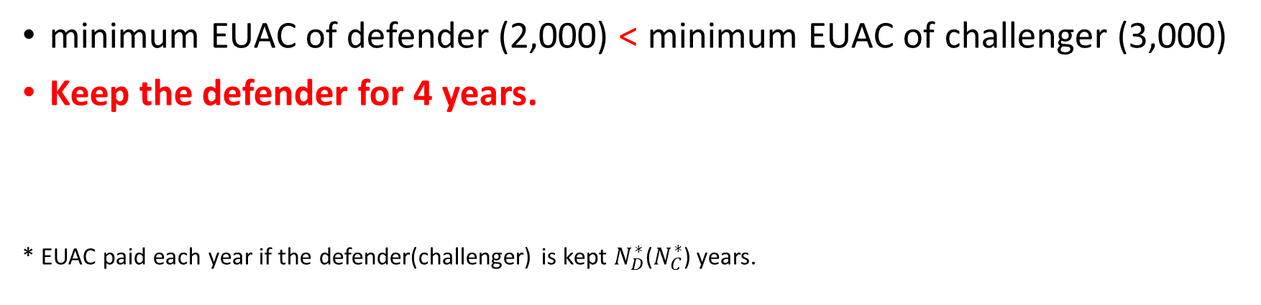
When to change the defender Scenario 1
 | Economic Life (years) | EUAC ($)*
Defender | 4 | 2,000
Challenger | 3 | 3,000
If kept, it is best to keep the defender for 4 years.
If bought, it is best to keep the challenger for 3 years.
minimum EUAC of defender (2,000) < minimum EUAC of challenger (3,000)
Keep the defender for 4 years.
* EUAC paid each year if the defender(challenger) is kept $N_{D}^{∗}$($N_{C}^{∗}$) years.

Slide 4
When to change the defender Scenario 2
 | Economic Life (years) | EUAC ($)
Defender | 4 | 2,000
Challenger | 3 | 1,500
If kept, it is best to keep the defender for 4 years.
If bought, it is best to keep the challenger for 3 years.
minimum EUAC of defender (2,000) > minimum EUAC of challenger (1,500)
Change the defender now !

Slide 5
When to change the defender Scenario 3
 | Economic Life (years) | EUAC ($)
Defender | 2 | 2,000
Challenger | 3 | 1,500
If kept, it is best to keep the defender for 2 years.
If bought, it is best to keep the challenger for 3 years.
minimum EUAC of defender (2,000) > minimum EUAC of challenger (1,500)
Change the defender now !
Note that the difference between the economic lives of the defender in scenario 2 and 3 does not affect the final decision as the minimum EUAC is higher than the minimum EUAC of the challenger in both scenarios.

Slide 6
When to change the defender Scenario 4
 | Economic Life (years) | EUAC ($)*
Defender | 2 | 2,000
Challenger | 3 | 3,000
If kept, it is best to keep the defender for 2 years.
If bought, it is best to keep the challenger for 3 years.
minimum EUAC of defender (2,000) < minimum EUAC of challenger (3,000)
Keep the defender for at least 2 years.

Slide 7
When to change the defender Scenario 4
Note that a decision to keep the defender does not mean that it should be kept only for this period of time.
Indeed, the defender should be kept longer than the apparent economic life as long as its marginal cost* is less than the minimum EUAC for the best challenger.
So, we should further analyze the marginal costs for scenario 4.
Let’s create 2 sub-scenarios; 4.1 and 4.2
*Recall that the marginal cost was the total cost for an additional year of service

Slide 8
When to change the defender Scenario 4.1
 | Economic Life (years) | EUAC ($)*
Defender | 2 | 2,000
Challenger | 3 | 3,000
We need marginal cost details (of the defender) to determine the number of additional years (if any) it will be kept.
Year | TC_{k} (Defender)
1 | 1,500
2 | 2,500
3 | 2,750
4 | 3,500
The marginal cost of the 3rd year is 2,750 < 3,000. So it is less costly to keep the defender at the third year.
The marginal cost of the 4th year is 3,500 > 3,000. So it is more costly to keep the defender at the fourth year.
Change the defender at the end of the third year.

Slide 9
When to change the defender Scenario 4.2
 | Economic Life (years) | EUAC ($)*
Defender | 2 | 2,000
Challenger | 3 | 3,000
We need marginal cost details (of the defender) to determine the number of additional years (if any) it will be kept.
Year | TC_{k} (Defender)
1 | 1,500
2 | 2,500
3 | 3,500
4 | 4,000
The marginal cost of the 3rd year is 3,500 > 3,000. So it is more costly to keep the defender at the third year.
Change the defender at the end of the second year.
If TC₃ was 3,000, we would be indifferent between changing the defender or keeping it in the 3rd year.

